Slide 1
1
Food Distribution Program
Create New Users in WBSCM
Texas Department of Agriculture
USDA Division

Slide 2
2
Why WBSCM?
The FDP Module in TX-UNPS does not have an upgrade.
In 2010, USDA launched the Web Based Supply Chain Management System (WBSCM) specifically to support FDP.
USDA owns and regularly upgrades WBSCM, making it the best solution to serve RAs in Texas now and in the future.

Slide 3
Acknowledgement Statement
You understand and acknowledge that:
The training you are about to take does not cover the entire scope of the program; and that
You are responsible for knowing and understanding all handbooks, manuals, alerts, notices, and guidance, as well as any other forms of communication that provide further guidance, clarification, or instruction on operating the program.

Slide 4
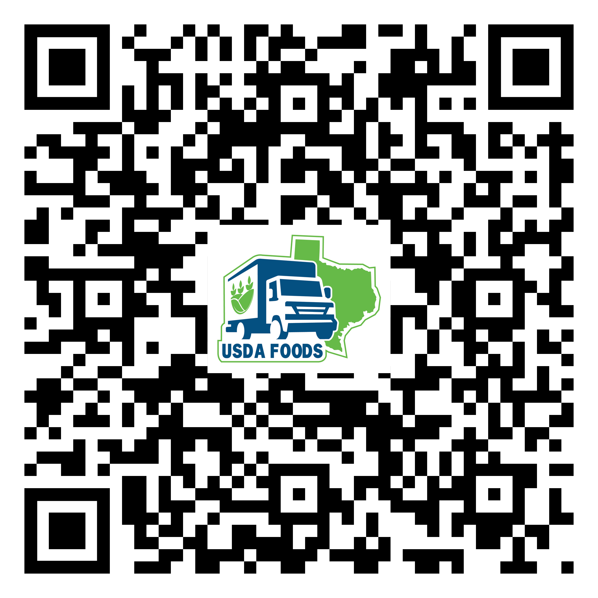
4
WBSCM Transition Page QR Code:
Scan QR Code to visit the Food Distribution Program WBSCM Transition website

Slide 5
5
01
Course Introduction
Course Outline and Objectives

Slide 6
6
Introduction
01
Course Overview and Objectives
02
Create New User
Navigate portal pathways to create new users
03
Assign User Role(s)
Assign user roles based on appropriate job function
WBSCM Entitlement
Course Outline

Slide 7
7
Course Objectives and Outcomes
By the end of this course, participants will be able to:
Understand how User Administrators create a new user and assign security roles in WBSCM.

Slide 8
8
02
Create New User
Portal Pathway

Slide 9
9
WHEN
WHY
Use this procedure when new staff join RA Organizations​
Use this procedure to create new users and assign security roles in WBSCM.

Slide 10
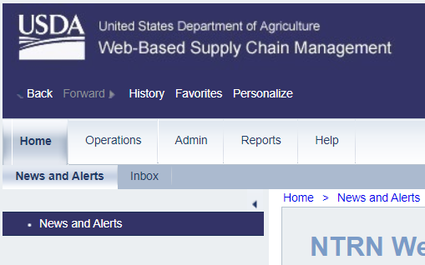
10
Create A New User
To create a new user, follow the steps on each slide.
Click on Admin
Notes:
The next slides will review portal pathways and directions to create a new user in WBSCM. Follow all directions as described on each slide.

Slide 11
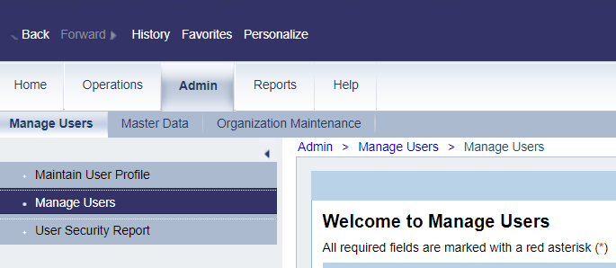
11
Create A New User
Click on Manage Users

Slide 12
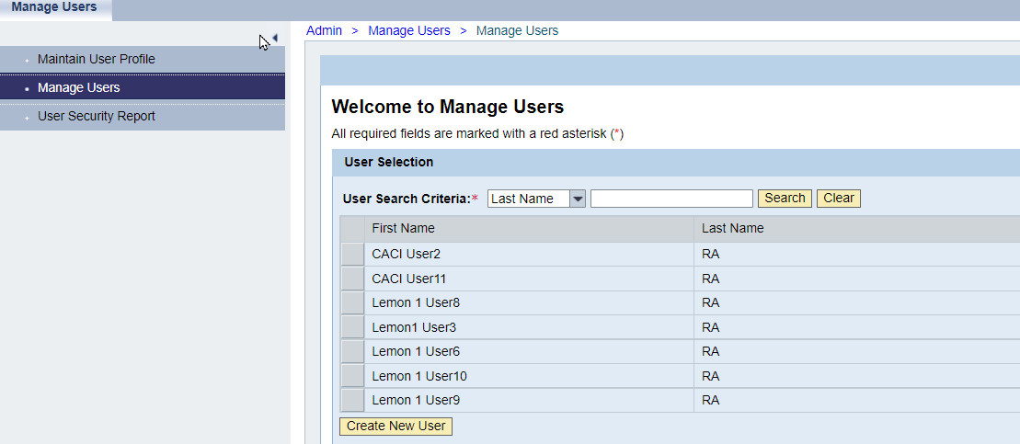
12
Create A New User
User Search Panel
Existing users listed here

Slide 13
13
Create A New User
Enter New User Name in the Search Criteria field to prevent creating duplicate user profiles

Slide 14
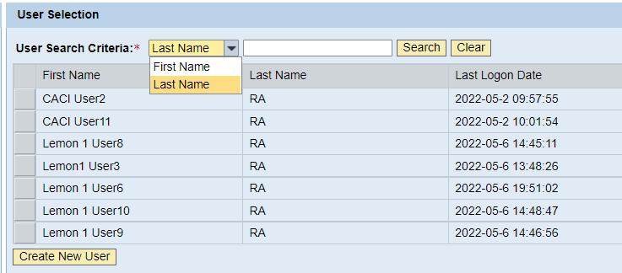
14
Create A New User
Click on dropdown to search by First Name if desired

Slide 15
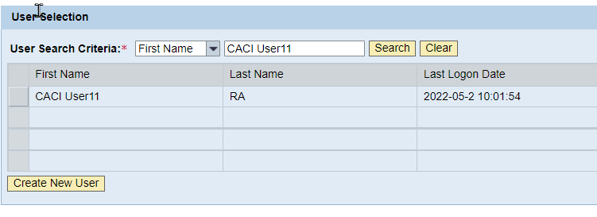
15
Create A New User
Enter Name of New User to Prevent Duplication

Slide 16
16
Create A New User
If user appears in search, do not continue creating new user
Review and update existing user profile

Slide 17
17
Create A New User
If no profile exists, continue and click Create New User

Slide 18
18
Create A New User
User Details Panel will appear after clicking Create New User

Slide 19
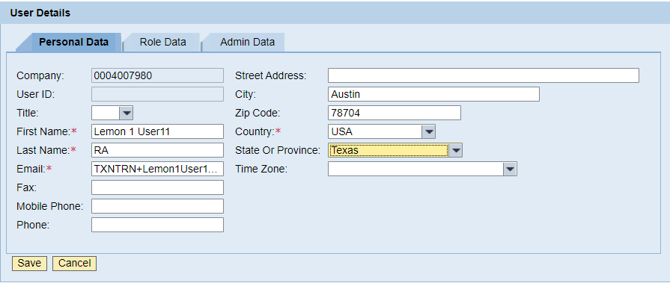
19
Create A New User
Enter New User Information
Complete required fields.
Enter City, State, and Zip Code to prevent error message and continue new user creation.
Enter all known data if possible.

Slide 20
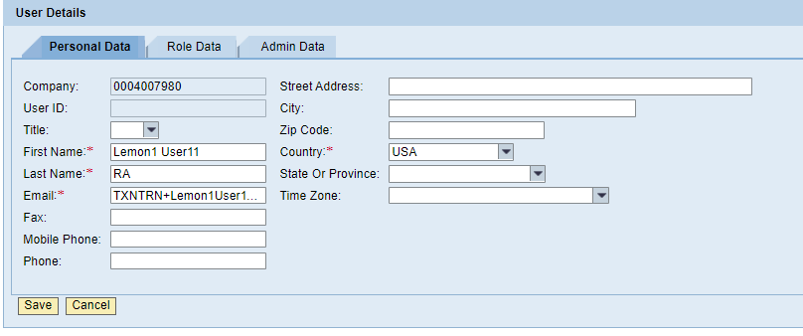
20
Create A New User
Click save.

Slide 21
21
Assign Role Data
Click on the Role Data tab to assign user role(s).

Slide 22
22
Assign Role Data
All available roles for new users appear in the Available Roles column.
All roles currently assigned to new user will appear in the Current Roles column.

Slide 23
23
WBSCM RA User Roles
RA User Roles
1) Org Admin-RA | Maintains organization data and view users assigned to its organization.
2) User Admin-RA | Can create new users, update contact information, update assigned roles for users within their RA organization, and deactivate user accounts that are no longer needed.
3) Order Manager-RA | Role tasks include, but not limited to, creating requisitions, running entitlement/bonus reports, etc.
4) View Only-RA | ﻿Has access to order management, material pricing, and entitlement reports.

Slide 24
24
Assign Role Data
Click on role to assign user

Slide 25
25
Assign Role Data
Click “Add” after selecting desired role

Slide 26
26
Assign Role Data
Selected role will appear in Current Roles panel.

Slide 27
27
Assign Role Data
Repeat the process to assign additional roles to user if needed

Slide 28
28
Assign Role Data
Click Save After Adding All Desired User Role(s)

Slide 29
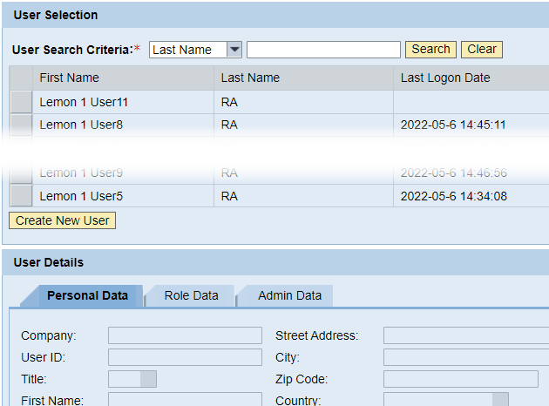
29
Create A New User
New user will appear in the User Selection Panel
User Details are cleared and ready for creation of additional users.

Slide 30
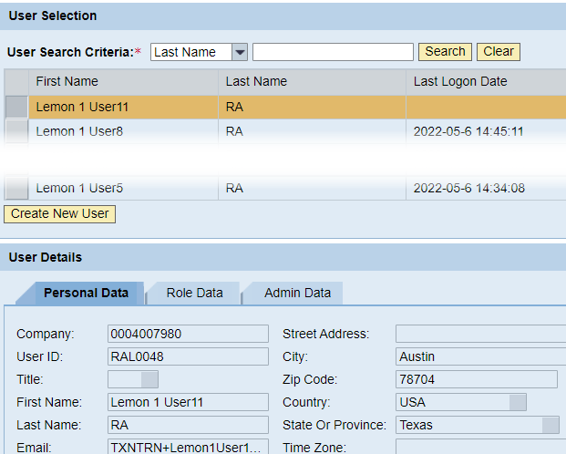
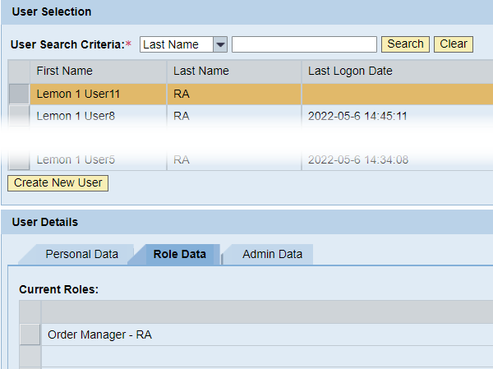
30
Create A New User
Select user and click on “Personal Data” and “Role Data” tabs to confirm user information.

Slide 31
31
Create A New User
Create New User Complete!
Repeat process to create new users as needed.

Slide 32
For WBSCM Assistance
See Contact Information Section on WBSCM Transition Page

Slide 33
33
Questions?

Slide 34
34

Slide 35
35
Contact Us
https://squaremeals.org/Programs/FDPWBSCMTransitionProject.aspx
Diana Chavarria
CN Technical Support
Diana.Chavarria@esc15.net
325.658.6571

